Slide 1

Bases de Dados - Dorlux
Presentation - Group 11
Simão Quintela (#A97444)
Miguel Ângelo Freitas (#A91635)
Hugo Rocha (#A96463)
Ioannis Nezis (#E10785)

Slide 2

Presentation Structure
Throwback (what happened before)
Physical implementation
Creation
Population
Database Size and growth tax
Queries
Security and Recovery plan
Conclusion and Future work
Bases de Dados – Dorlux | Presentation - Group 11

Slide 3
1- Throwback
What's Dorlux?
Last checkpoint
Bases de Dados – Dorlux | Presentation - Group 11

Slide 4
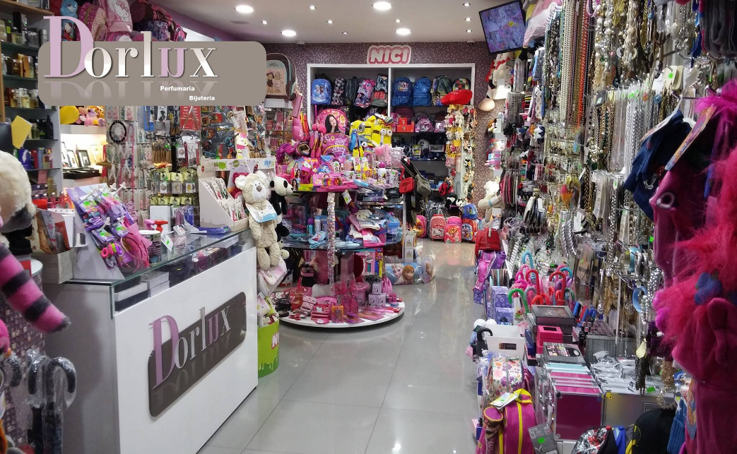
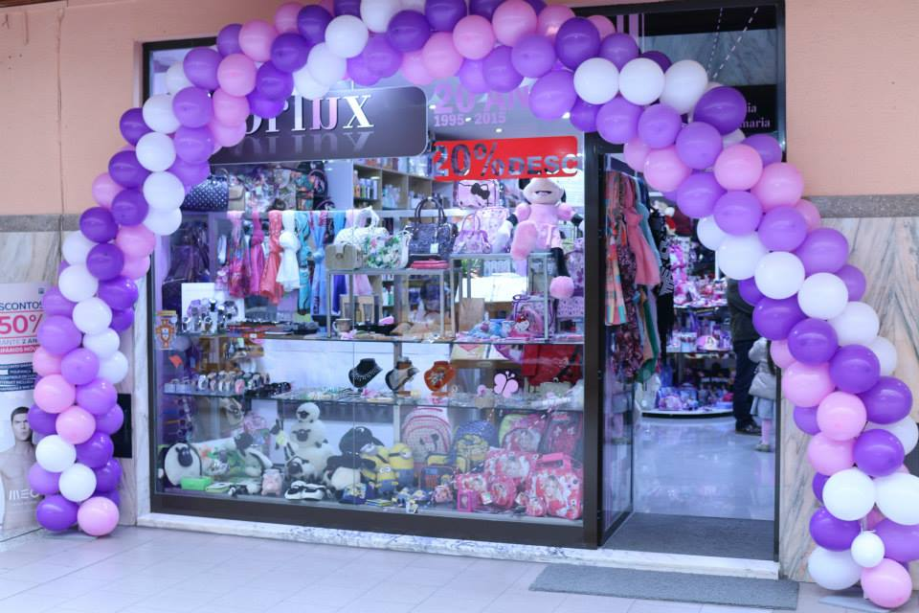
What's Dorlux?
Dorlux is a gift shop located in a small mall at Vila das Taipas, Guimarães. It was created in 1996 by Mrs. Dores as a way to start an independent business.
Bases de Dados – Dorlux | Presentation - Group 11

Slide 5
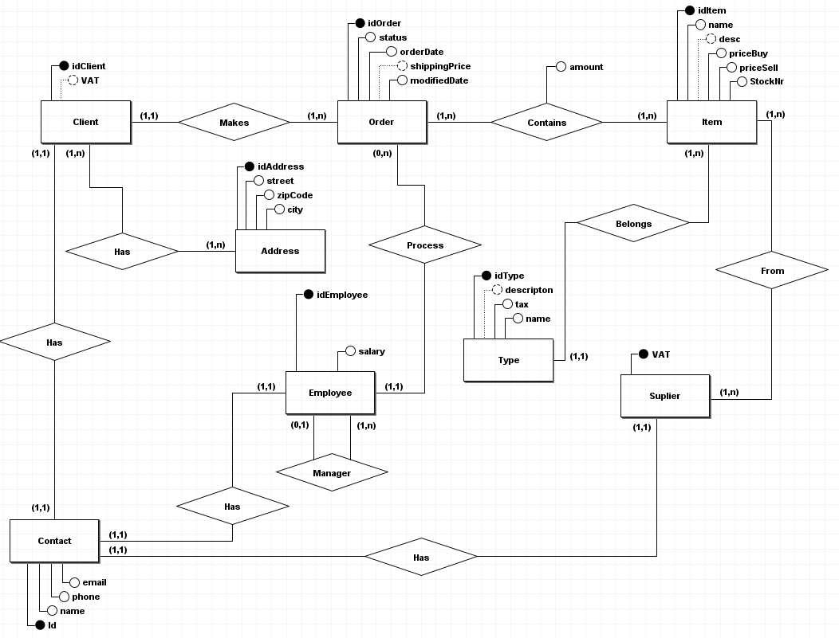
Last Checkpoint – Conceptual Model
Bases de Dados – Dorlux | Presentation - Group 11

Slide 6
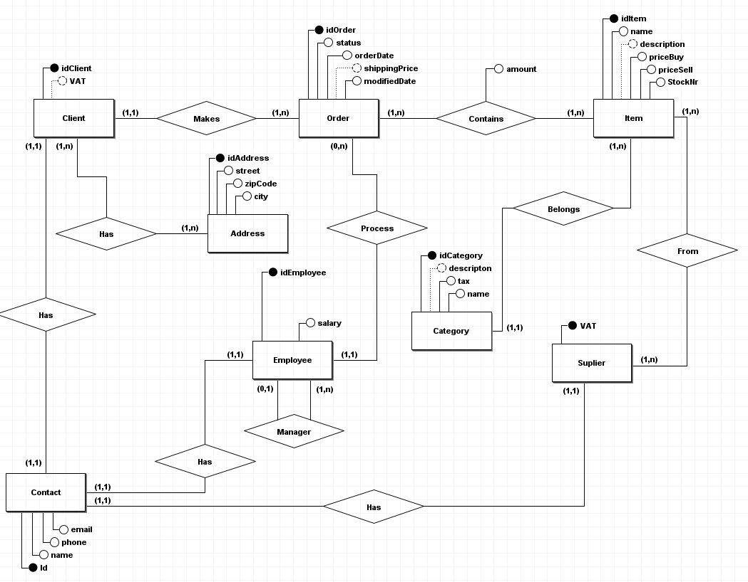
Today - Conceptual Model
Bases de Dados – Dorlux | Presentation - Group 11

Slide 7
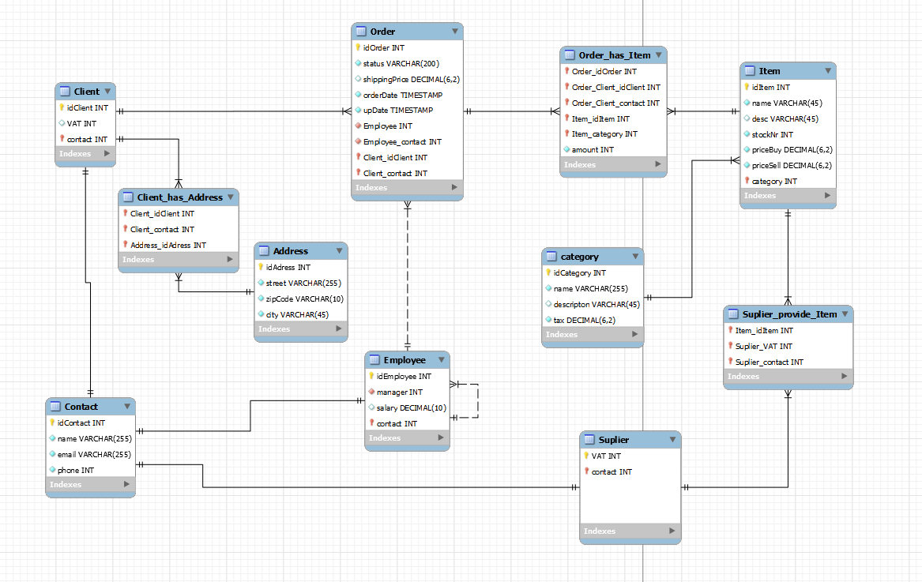
Last Checkpoint – Logic Model
Bases de Dados – Dorlux | Presentation - Group 11

Slide 8
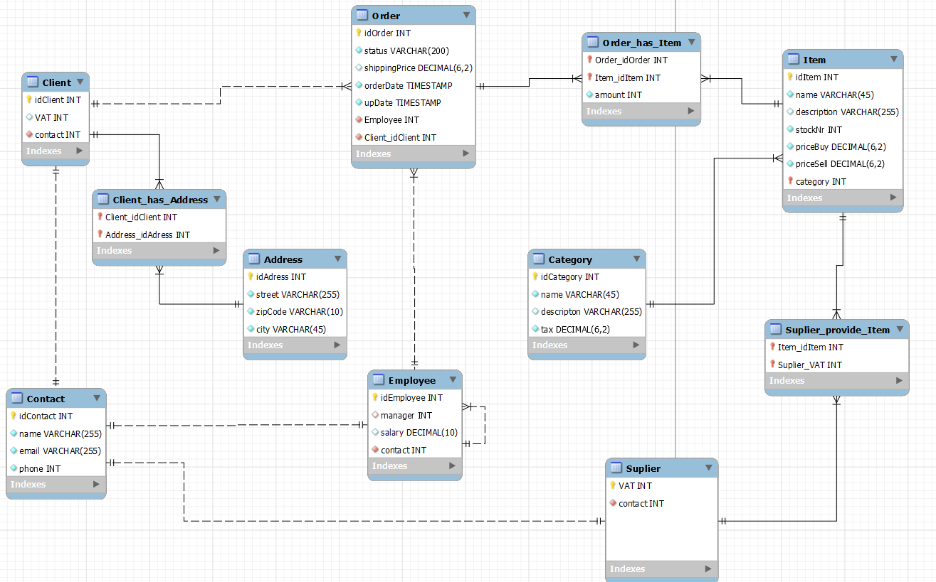
Today - Logic Model
Bases de Dados – Dorlux | Presentation - Group 11

Slide 9
2- Requirements
Type of requirements:
Description
Control
Manipulation
Bases de Dados – Dorlux | Presentation - Group 11

Slide 10
Descripton requirements
Nr | Description
RD01 | The characterization of a customer in the database must include a unique identifier and optionally an associated tax number. It must also, obligatorily, include a contact
RD02 | An address must contain a unique identifier, street name, postal code and city of residence.
RD03 | A contact must contain a unique identifier, the name of the person/institution in question, email and mobile phone number.
RD04 | Each order must have a unique identifier, a status, an optional order shipping price, an order entry date, and a date with the last change made to the order. It must also have an identifier for the employee responsible for the order, and an identifier for the customer who placed the order.
RD05 | The employee entity must have a unique identifier, a field that identifies the manager, a field that identifies the employee's salary, and a field that contains a unique identifier for the employee's contact.
RD06 | A supplier must contain his NIF as a unique identifier and a contact
RD07 | A category must contain a unique identifier as well as its name, a description and the tax associated with that category.
RD08 | An item contains a unique identifier, its name, a description of the item, a field that indicates the stock number of that item, its sale and purchase price and also the category to which it belongs
Bases de Dados – Dorlux | Presentation - Group 11

Slide 11
Exploration requirements
Nr | Description
RE01 | It must be possible to change the status of the order and update the last operation performed.
RE02 | It must be possible to insert new contacts
RE03 | It must be possible to change contact information
RE04 | It must be possible to delete a contact
RE05 | It should be possible to list all orders placed on a certain day of the month
RE06 | It must be possible to list orders in a given status of a given category of items
RE07 | It must be possible to list all orders with the delivery address of the customer corresponding to the order
RE08 | It must be possible to list all orders assigned to a given employee
RE09 | It should be possible to list all orders placed by a customer
RE10 | It must be possible to make a top X of customers, where the value of X is up to the user
RE11 | It must be possible to know how many and which items we buy from a certain supplier
RE12 | It must be possible to list the stock of available items
RE13 | It should be possible to sort items by stock number
RE14 | It should be possible to sort categories by name
RE15 | It should be possible to sort employees in descending order of salary
Bases de Dados – Dorlux | Presentation - Group 11

Slide 12
Control requirements
Nr | Descrição
RC01 | A customer can only have one contact
RC02 | A supplier can only have one contact
RC03 | An employee can only have one contact
RC04 | A customer can have multiple addresses and multiple addresses can be associated with multiple customers
RC05 | A customer can place several orders, but an order is associated with only one customer.
RC06 | An order can have several items and several items can be present in several orders
RC07 | An order can only be associated with one employee, but an employee can be associated with multiple orders.
RC08 | One item can be supplied by multiple suppliers and one supplier can supply multiple items.
RC09 | A category incorporates several items, however an item only belongs to one category
RC10 | An order contains a certain quantity of an item.
Bases de Dados – Dorlux | Presentation - Group 11

Slide 13
3 - Pyshical Implementation
Creation
Population
Database Size and growth tax
Queries
Bases de Dados – Dorlux | Presentation - Group 11

Slide 14
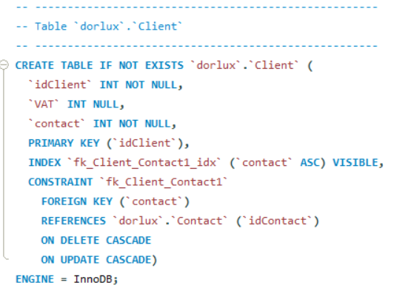
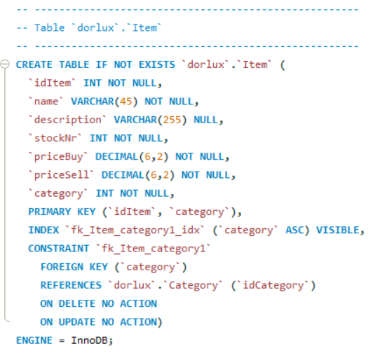
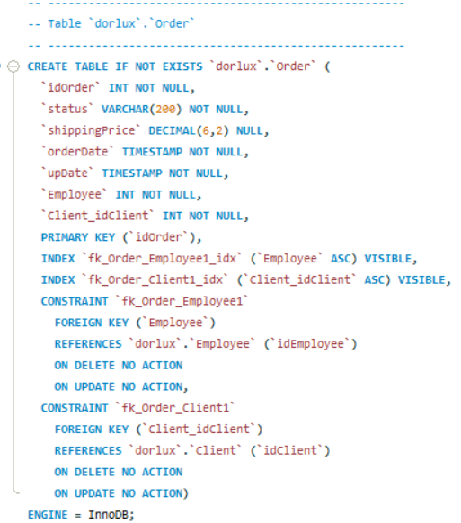
Creating Tables
Bases de Dados – Dorlux | Presentation - Group 11

Slide 15
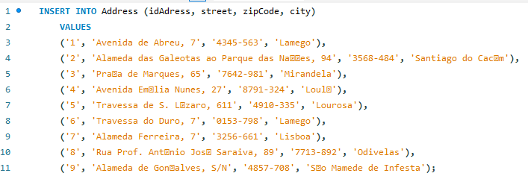
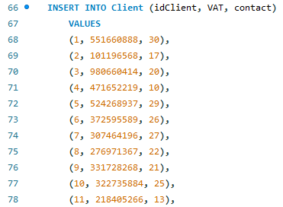
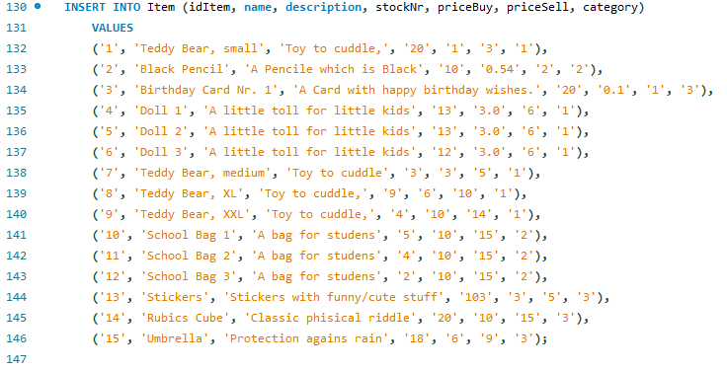
Population
Bases de Dados – Dorlux | Presentation - Group 11

Slide 16
Database size and growth tax
Tipo | Tamanho
Int | 4 bytes
Float | 4 bytes
Datetime | 5 bytes
Date | 3 bytes
Decimal (X, Y) | 8 bytes*
Varchar (N) | N+1 ou 2xN+1 ou 2xN+2**
Atributo | Tipo | Tamanho
idOrder | INT | 4 bytes
Status | VARCHAR (200) | 402 bytes
shippingPrice | DECIMAL (6,2) | 8 bytes
orderDate | DATETIME | 5 bytes
upDate | DATETIME | 5 bytes
Employee | INT | 4 bytes
Client_idClient | INT | 4 bytes
Atributo | Tipo | Tamanho
idClient | INT | 4 bytes
VAT | INT | 4 bytes
contact | INT | 4 bytes
Atributo | Tipo | Tamanho
idContact | INT | 4 bytes
name | VARCHAR (255) | 512 bytes
email | VARCHAR (255) | 512 bytes
phone | INT | 4 bytes
Bases de Dados – Dorlux | Presentation - Group 11

Slide 17
Database size and growth tax
An estimate of the space occupied by the unpopulated database of 3312 bytes can be obtained.
Assuming an annual growth of 13% in the number of customers and currently having 30 customers in the system, the growth of the database will be calculated by (30 * 0.13) * 1044 ≈ 4071.6 bytes, that is, it is to be expected that in one year, in terms of customers, the database grows by 4.1 KB.
As for the growth of orders, it is estimated that there will be an annual growth of 20% (taking into account that new customers and potential customers may return to make purchases), since there are currently 50 orders in the database, the annual growth of orders is given by (50*0.2) * 432 ≈ 4320 bytes, that is, during one year, regarding orders, it is expected that the database will grow by 4.3KB.
Bases de Dados – Dorlux | Presentation - Group 11

Slide 18
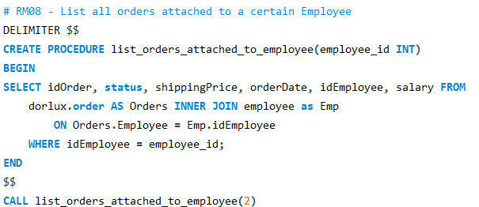
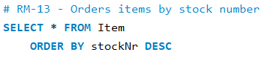
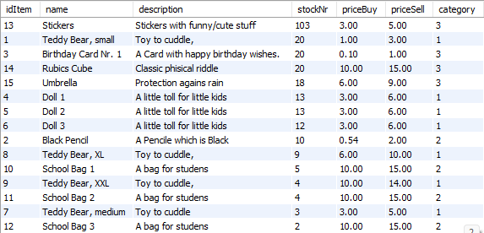
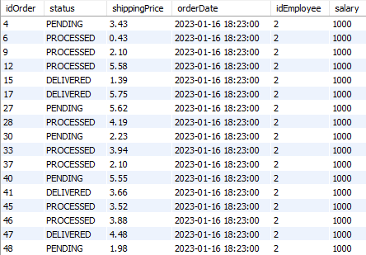
Queries
Bases de Dados – Dorlux | Presentation - Group 11

Slide 19
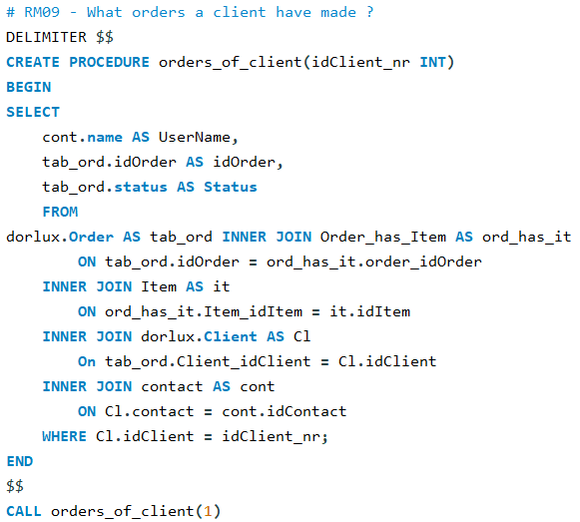
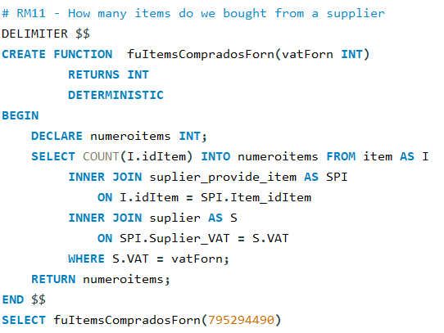
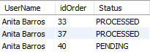
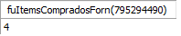
Queries
Bases de Dados – Dorlux | Presentation - Group 11

Slide 20
Security and Recovery plan
For security and recovery plan we covered this points
Save the latest creation script
Save the latest population script
Store the project on a private repository
Bases de Dados – Dorlux | Presentation - Group 11

Slide 21
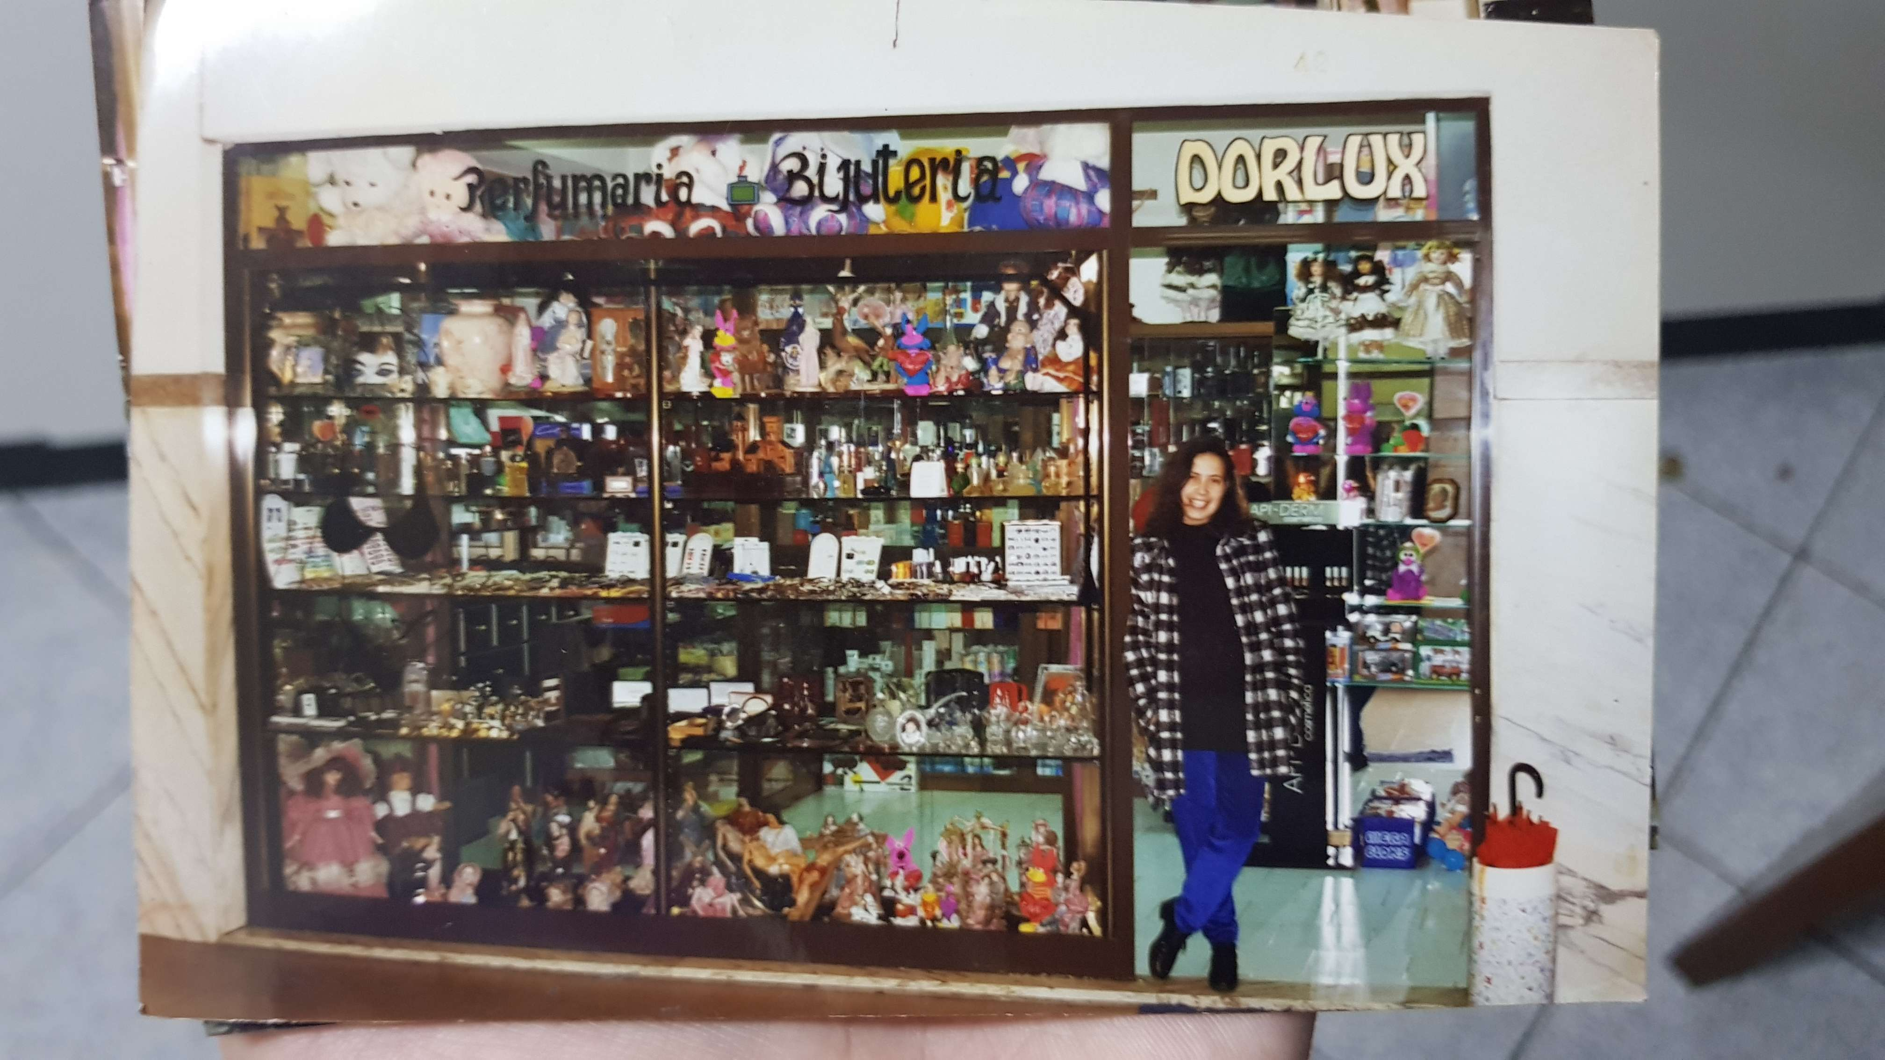
Conclusion
Bases de Dados – Dorlux | Presentation - Group 11

Slide 22
THANK YOU!

Slide 23
Bases de Dados - Dorlux
Presentation - Group 11
Simão Quintela (#A97444)
Miguel Ângelo Freitas (#A91635)
Hugo Rocha (#A96463)
Ioannis Nezis (#E10785)

